Slide 1
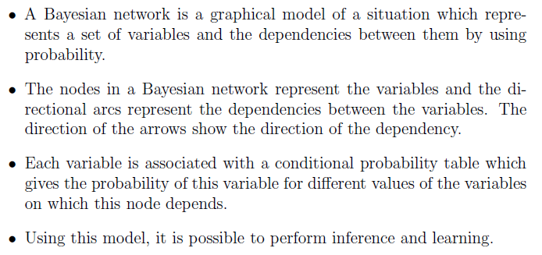

BAYESIAN NETWORK

Slide 2
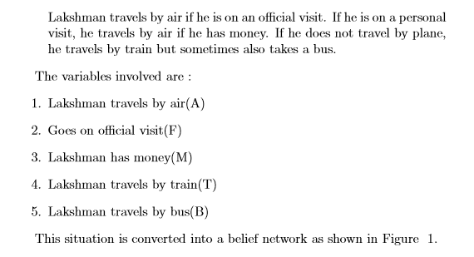
BAYESIAN NETWORK

Slide 3
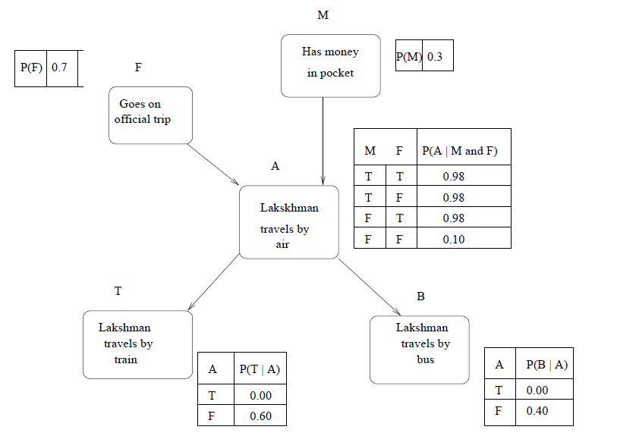
A Sample Bayesian Network

Slide 4
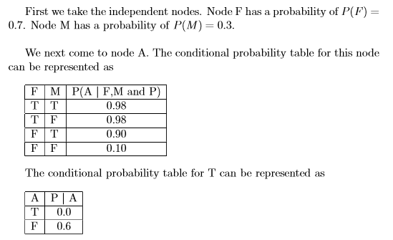
A Sample Bayesian Network

Slide 5
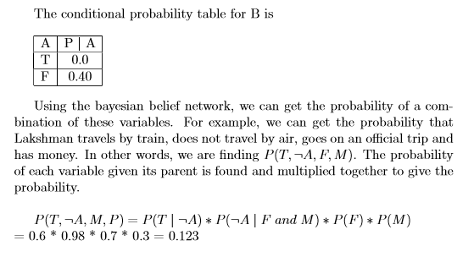
A Sample Bayesian Network

